Slide 1

http://igniteitserve.com/
Feature Engineering-
Retail Price Prediction

Slide 2
Agenda
Case study- Retail segment
Understanding the problem
Data wrangling and exploratory analysis
Feature Engineering
Numerical features
Categorical features
Feature Selection
Key Pandas Snippets

Slide 3
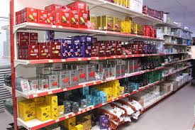
Case Study- Retailx Price Prediction
Retailx Portal is an online marketplace that allows individuals to buy and sell new and used items, such as electronics, jewellery, apparel, shoes, books, CDs, DVDs and home accessories. The company was established in Japan and subsequently extended its operations to US and UK markets.

Slide 4
Description- Retailx Price Prediction
Among those Japanese users utilizing one of the country’s many community marketplace apps, 94% were found to be using this portal. The business pitch adopted by Retailx for its mobile app is “Retailx, The Selling App.”
Retailx organized a challenge in which they published some of the products information. Data is available for approximately 1.4 million products. In this competition, Retailx is challenging you to build an algorithm that automatically suggests the right product prices. You’ll be provided user-inputted text descriptions of their products, including details like product category name, brand name, and item condition.
Retailx would like to put the best model into production and suggest users the realistic price along with the real time comparison, whenever any new item is getting uploaded for the sale.

Slide 5
Dataset- Retailx Price Prediction
Dataset Summary- The dataset:
The competition test file is a TSV file with a list of product announcements with the following attributes:
name,
item description,
Item condition id,
category name,
brand-name,
shipping (1 if shipping fee is paid by seller and 0 by buyer)
price , target field, in US Dollars
Train set is having over than 1.4 Million products listed
Test set had about 700,000 products

Slide 6
Dataset Snapshot
Number of variables 8
Number of observations 1482535
Total Missing (%) 5.4%
Total size in memory 90.5 MiB
Avg record size in memory 64.0 B
Variables types
Numeric 3
Categorical 4
Boolean 1
Warnings
brand_name has 632682 / 42.7% missing values Missing
brand_name has a high cardinality: 4810 distinct values Warning
category_name has a high cardinality: 1288 distinct values Warning
item_description has a high cardinality: 1281427 distinct values Warning
name has a high cardinality: 1225273 distinct values Warning

Slide 7


Data wrangling and exploratory analysis

Slide 8




The Dream...
Raw data
Dataset
Model
Task

Slide 9


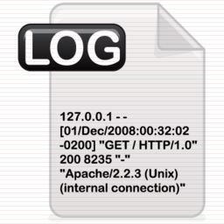





… The Reality
?
Model
?
Features
ML Ready dataset
Task
Raw data

Slide 10


*Google Colab is a free cloud service based on Jupyter Notebooks for machine learning education and research. It provides a runtime fully configured for deep learning *Saves to Google Drive, which allows you to also share and have multiple people work on the same document at once *Collapsible section and section tree *Interactive widgets like sliders *Scratch cell: A cell to run test code but which isn’t saved in your notebook *Code snippets & pdb debugger support * And the best is for the last…..??
Why use Colab??

Slide 11

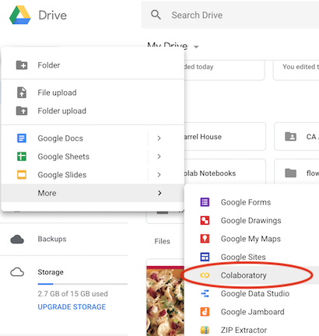
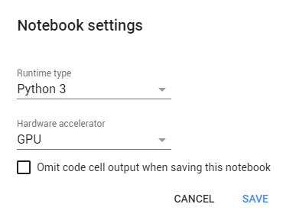
Getting Started With Google Colab-
Adv of Google Colab

Slide 12

First at all … know your data!
What does the data model look like?
What is the features distribution?
What are the features with missing or inconsistent values?
What are the most predictive features?

Slide 13




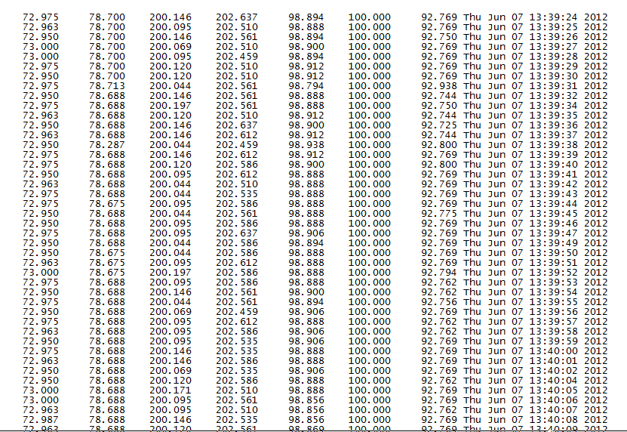
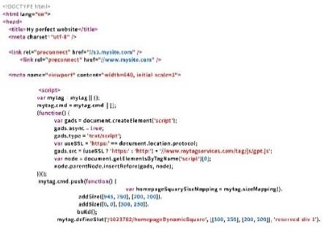









Loading test.tsv File from Gdrive
CSV File
Program Data
Program
df= pd.read_csv("/content/drive/My Drive/retail/train.tsv",delimiter='\t')

Slide 14
Data snapshot
train_id | name | item_condition_id | category_name | brand_name | price | shipping | item_description
0 | MLB Cincinnati Reds T Shirt Size XL | 3 | Men/Tops/T-shirts | NaN | 10 | 1 | No description yet
1 | Razer BlackWidow Chroma Keyboard | 3 | Electronics/Computers & Tablets/Components & P... | Razer | 52 | 0 | This keyboard is in great condition and works ...
2 | AVA-VIV Blouse | 1 | Women/Tops & Blouses/Blouse | Target | 10 | 1 | Adorable top with a hint of lace and a key hol...
3 | Leather Horse Statues | 1 | Home/Home Décor/Home Décor Accents | NaN | 35 | 1 | New with tags. Leather horses. Retail for [rm]...
4 | 24K GOLD plated rose | 1 | Women/Jewelry/Necklaces | NaN | 44 | 0 | Complete with certificate of authenticity

Slide 15










Data Exploration Techniques
Dimensionality Check
The shape attribute returns a two-item tuple (number of rows and the number of columns) for the data frame. For a Series, it returns a one-item tuple.
Type of Dataset
Slicing and Indexing
df.shape
Identifying Unique Elements
Value Extraction
Feature Mean Feature Median
Feature Mode

Slide 16
Data Exploration Techniques (Contd.)
Dimensionality Check
Type of Dataset
Slicing and Indexing
Code
Identifying Unique Elements
type(df)
Value Extraction
Feature Mean
Feature Median
df.shipping.dtype
Feature Mode

Slide 17
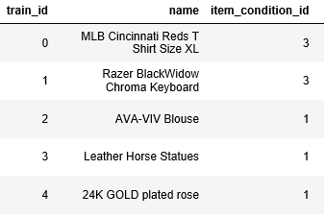
Data Exploration Techniques (Contd.)
Dimensionality Check
You can use the : operator with the start index on left and end index on right of it to output the corresponding slice.
Type of Dataset
Slicing and Indexing
Identifying Unique Elements
list[1:3]
Value Extraction
Feature Mean
df.iloc[:,1:3]
Feature Median
Feature Mode

Slide 18
Data Wrangling
The process of manually converting or mapping data from one raw format into another format is called data wrangling. This includes munging and data visualization.
Discovering
Structuring
Different Tasks in Data Wrangling
Cleaning
Validating
Enrichment

Slide 19
Need of Data Wrangling
Missing data, a very common problem
Presence of noisy data (erroneous data and outliers) Inconsistent data
Develop a more accurate model
Prevent data leakage

Slide 20
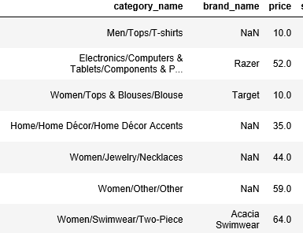
Missing / null Values

Slide 21
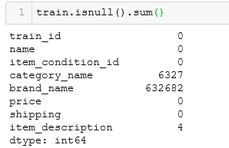
Missing Value Detection

Slide 22
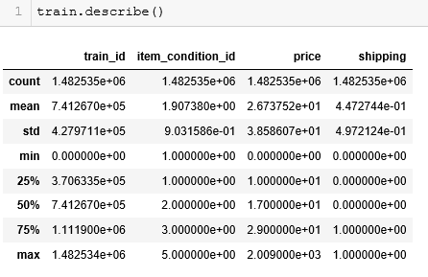
Using Pandas Describe

Slide 23
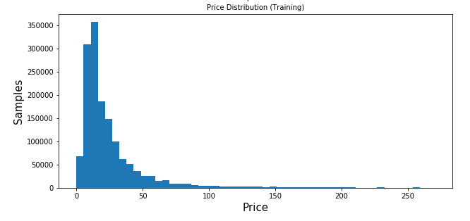
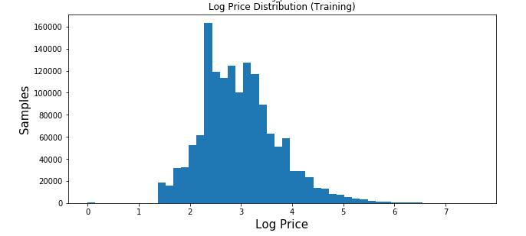
Price distribution details
Generally, Root Mean Squared Logarithmic Error (RMSE) metric is used for regression tasks.
Here we see price followed a long-tailed distribution (50% of the products were under $10), in order to make errors on low price product more relevant than for higher prices, the metric chosen for competition evaluation was #Root Mean Squared Logarithmic Error (RMSLE). Thus we need log transformation to the price target variable for model training.

Slide 24
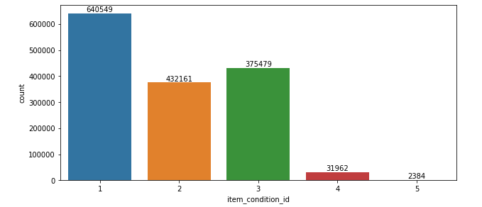
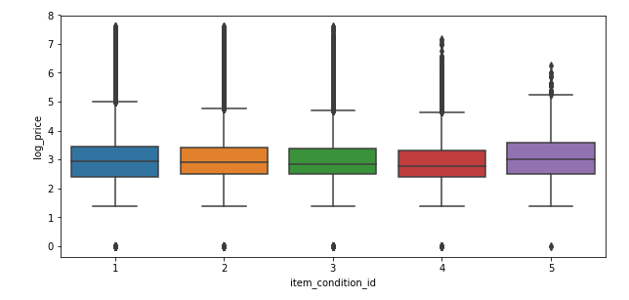
Category Details
~43% of the products are in the best condition. ~25% are in very good and ~30% products are in good/average condition. On the other hand, ~2% of the products are in bad/worse condition.

Slide 25
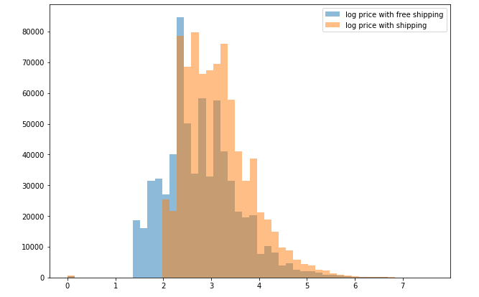
Log Prices Of shipping charges/ Free shipping
~55% of the products shipping is paid by the buyers and for ~45% of the products shipping is paid by the sellers.

Slide 26
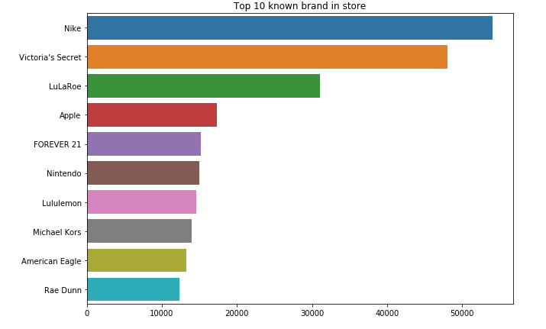
Top 10 Brands
~57% of the products have brand names. Nike is the most popular brand in terms of number of products

Slide 27
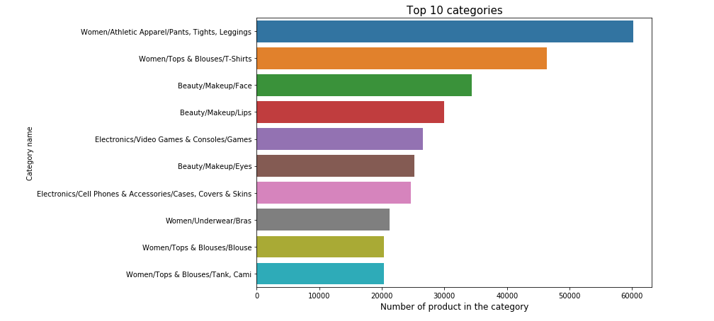
Top 10 Categories
~45% of the products are in category “Women”. Top most popular subcategories for category “Women” are “Athletic Apparel”.

Slide 28
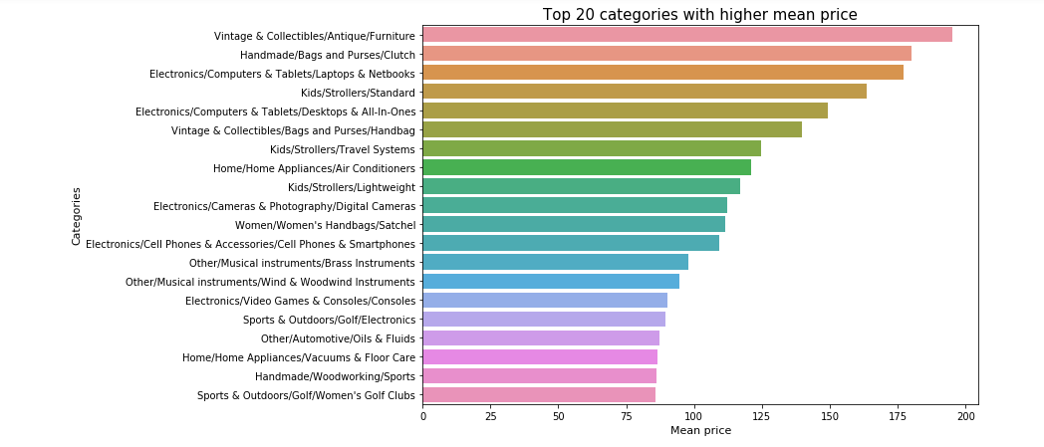
Top 20 categories by average price
Most expensive category in terms of mean prices is “Electronics” with a mean price of $35.18. In Electronics, most expensive subcategory is “Computers and Tablets” w mean price of $87.88.

Slide 29
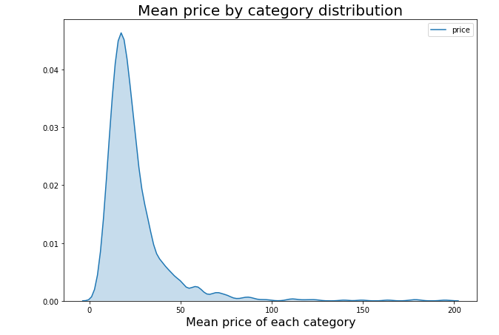
Are most items cheap?
75% of the products are under $30 and 99% of the products are under $170.

Slide 30
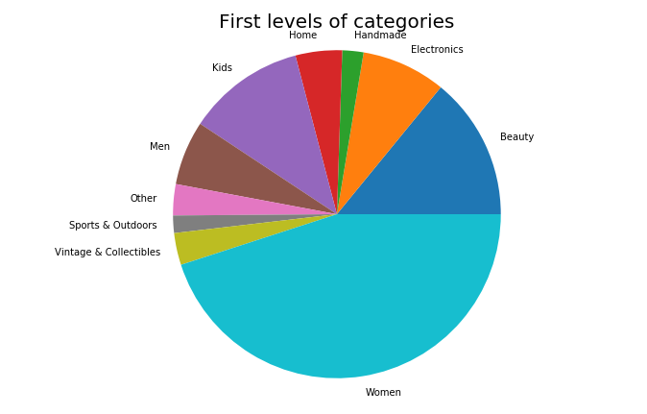
Splitting through Categories : Main
~45% of the products are in category “Women”.

Slide 31
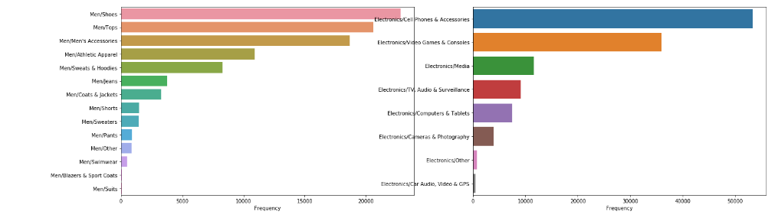
Splitting through Categories : Level 1

Slide 32
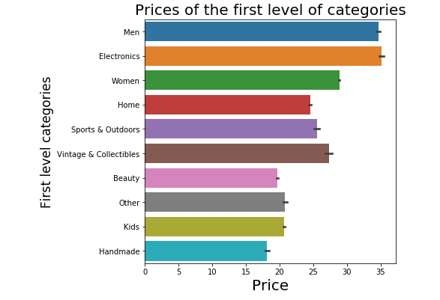
Prices of first level of categories
Most expensive category in terms of mean prices is “Electronics” with a mean price of $35.18. In Electronics

Slide 33
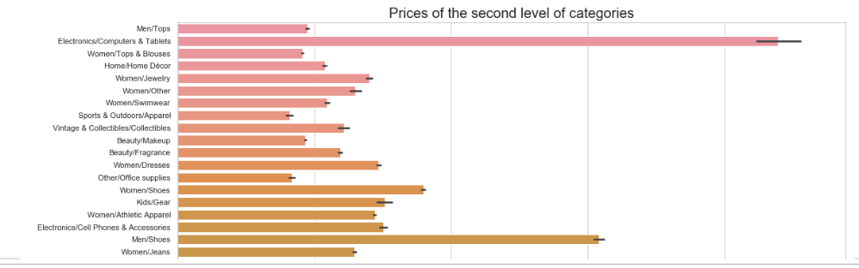
Prices of Second level of category
In 2nd level the most expensive subcategory is “Computers and Tablets” with a mean price of $87.88.

Slide 34
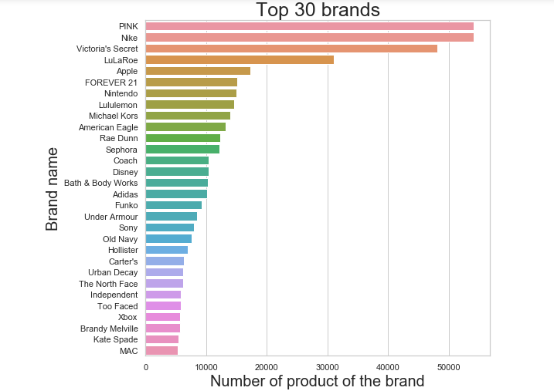
Top 30 brands
~57% of the products have brand names. PINK is the most popular brand in terms of number of products

Slide 35
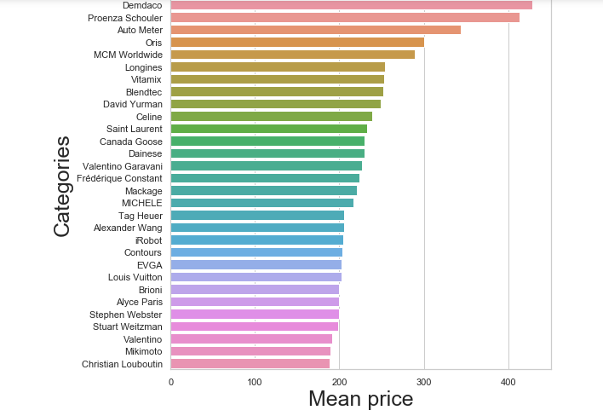
Top 30 expensive brands
Demdaco is the most expensive brand.

Slide 36
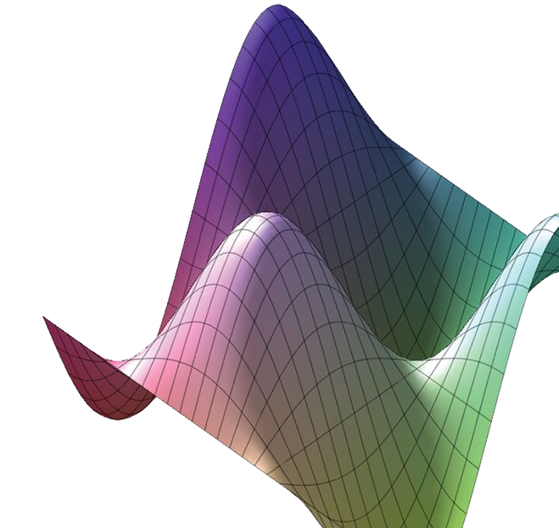
Numerical Features

Slide 37
Numerical features
Usually easy to ingest by mathematical models, but feature engineering is indeed necessary.
Can be floats, counts, ...
Easier to impute missing data
Distribution and scale matters to some models

Slide 38

Imputation for missing values
Datasets contain missing values, often encoded as blanks, NaNs or other placeholders
Ignoring rows and/or columns with missing values is possible, but at the price of loosing data which might be valuable
Better strategy is to infer them from the known part of data
Strategies
Mean: Basic approach
Median: More robust to outliers
Mode: Most frequent value

Slide 39
Binning
Adaptative or Quantile binning
Divides data into equal portions (eg. by median, quartiles, deciles)
df.price.describe()
Count 1.482535e+06
mean 2.673752e+01
std 3.858607e+01
Min 0.000000e+00
25% 1.000000e+01
50% 1.700000e+01
75% 2.900000e+01
max 2.009000e+03
Name: price, dtype: float64

Slide 40
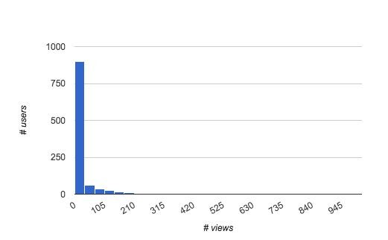
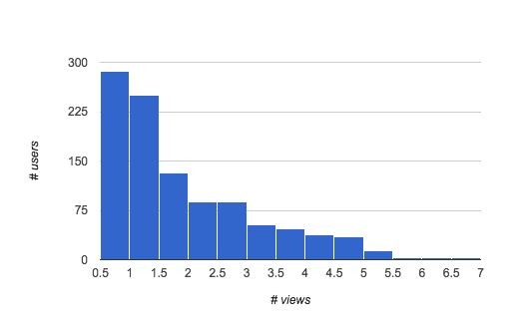
Log transformation
Smoothing long-tailed data with log
Histogram of price distribution
Histogram of price distribution smoothed by log(1+x)

Slide 41
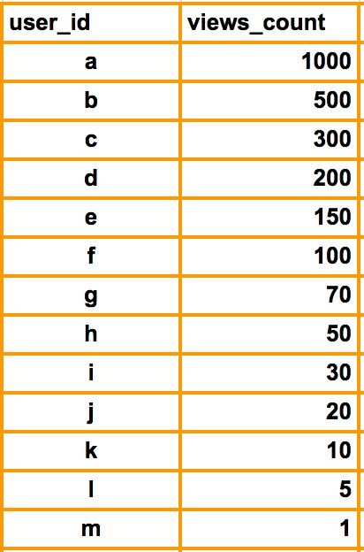
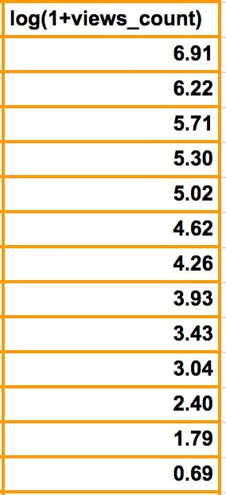
Log transformation
Compresses the range of large numbers and expand the range of small numbers. Eg. The larger x is, the slower log(x) increments.

Slide 42
Scaling
Models that are smooth functions of input features are sensitive to the scale of the input (eg. Linear Regression)
Scale numerical variables into a certain range, dividing values by a normalization constant (no changes in single-feature distribution)
Popular techniques
MinMax Scaling
Standard (Z) Scaling

Slide 43
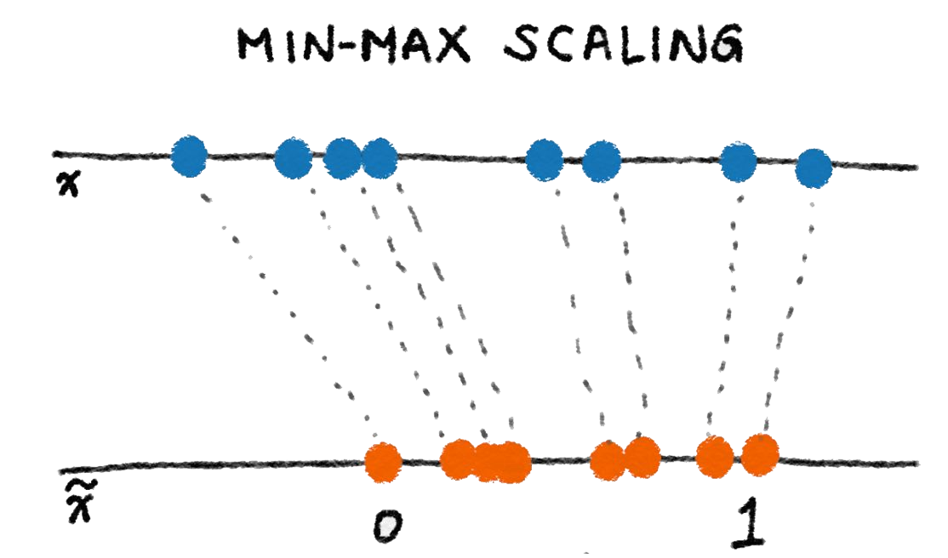
Min-max scaling
Squeezes (or stretches) all values within the range of [0, 1] to add robustness to very small standard deviations and preserving zeros for sparse data.
>>> from sklearn import preprocessing
>>> X_train = np.array([[ 1., -1., 2.],
... [ 2., 0., 0.],
... [ 0., 1., -1.]])
...
>>> min_max_scaler = preprocessing.MinMaxScaler()
>>> X_train_minmax = min_max_scaler.fit_transform(X_train)
>>> X_train_minmax
, 1. ],
array([[ 0.5 , 0.
[ 1. , 0.5
[ 0. , 1.
, 0.33333333],
, 0. ]])
Min-max scaling with scikit-learn

Slide 44
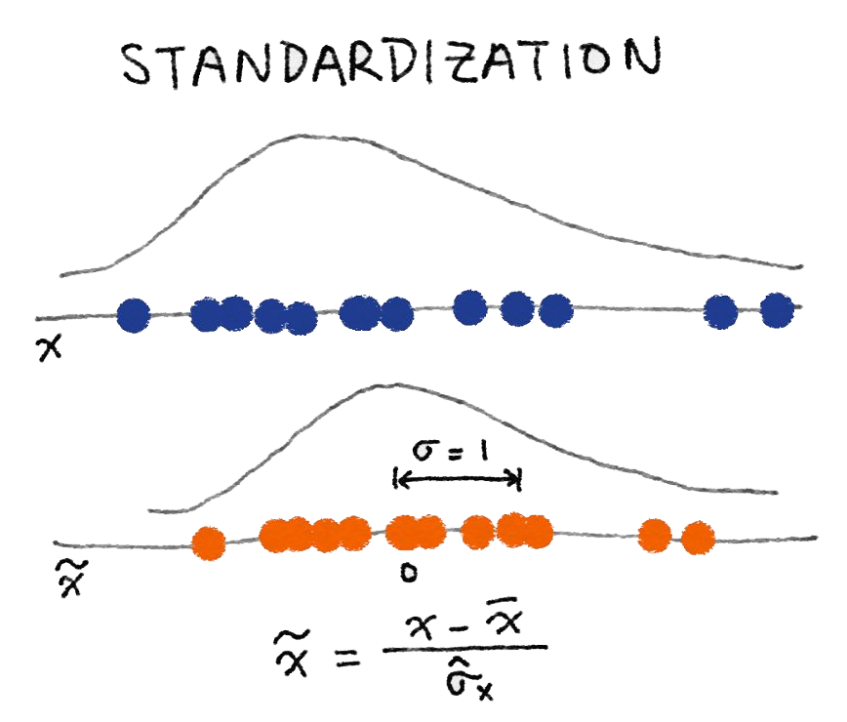
Standard (Z) Scaling
After Standardization, a feature has mean of 0 and variance of 1 (assumption of many learning algorithms)
>>> from sklearn import preprocessing
>>> import numpy as np
>>> X = np.array([[ 1., -1., 2.],
... [ 2., 0., 0.],
... [ 0., 1., -1.]])
>>> X_scaled = preprocessing.scale(X)
>>> X_scaled
array([[ 0. ..., -1.22..., 1.33...],
[ 1.22..., 0. ..., -0.26...],
[-1.22..., 1.22..., -1.06...]])
>> X_scaled.mean(axis=0) array([ 0., 0., 0.])
>>> X_scaled.std(axis=0) array([ 1., 1., 1.])
Standardization with scikit-learn

Slide 45
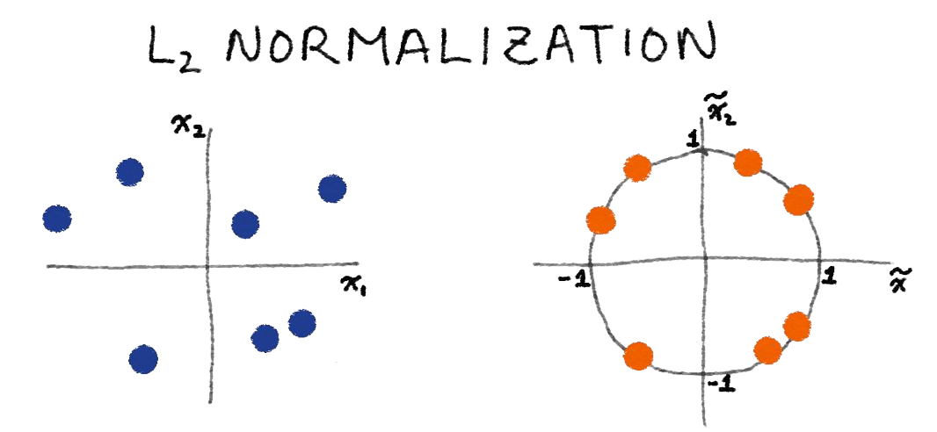

Normalization
Scales individual samples (rows) to have unit vector, dividing values by vector’s L² norm, a.k.a. the Euclidean norm
Useful for quadratic form (like dot-product) or any other kernel to quantify similarity of pairs of samples. This assumption is the base of the Vector Space Model often used in text classification and clustering contexts
Normalized vector
Euclidean (L²) norm

Slide 46

Categorical Features

Slide 47
Categorical Features
Nearly always need some treatment to be suitable for models
High cardinality can create very sparse data
Difficult to impute missing
Examples:
Platform: [“desktop”, “tablet”, “mobile”]

Slide 48
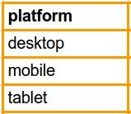
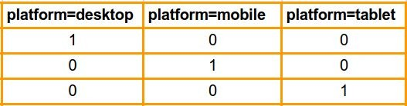
One-Hot Encoding (OHE)
Transform a categorical feature with m possible values into m binary features.
If the variable cannot be multiple categories at once, then only one bit in the group can be on.
Sparse format is memory-friendly
Example: “platform=tablet” can be sparsely encoded as “2:1”

Slide 49
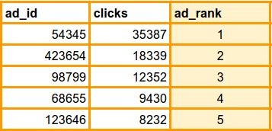
LabelCount encoding
Rank categorical variables by count in train set
Useful for both linear and non-linear algorithms (eg: decision trees)
Not sensitive to outliers
Won’t give same encoding to different variables

Slide 50
Time binning
Apply binning on time data to make it categorial and more general.
Binning a time in hours or periods of day, like below.
Hour range | Bin ID | Bin Description
[5, 8) | 1 | Early Morning
[8, 11) | 2 | Morning
[11, 14) | 3 | Midday
[14, 19) | 4 | Afternoon
[19, 22) | 5 | Evening
[22-24) and (00-05] | 6 | Night
Extraction: weekday/weekend, weeks, months, quarters, years...

Slide 51
“More data beats clever algorithms, but better data beats more data.”
– Peter Norvig

Slide 52
“...some machine learning projects succeed and some fail.
Where is the difference?
Easily the most important factor is the features used.”
– Pedro Domingos

Slide 53

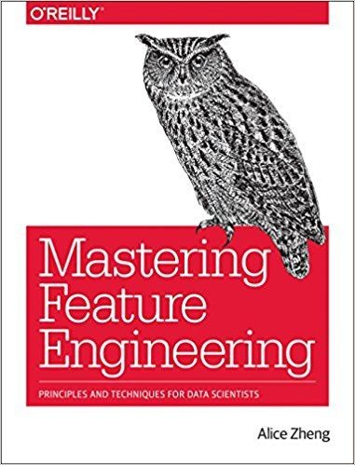
References
Scikit-learn - Preprocessing data Spark ML - Feature extraction Discover Feature Engineering..
https://towardsdatascience.com/the-complete-beginners-guide-to-data-cleaning-and-preprocessing-2070b7d4c6dPath to file
.

Slide 54
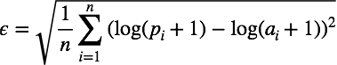
Section 2- ML algorithm

